Slide 1
Global Action Days:
My Actions Matter!
#MyActionsMatter #Handprint
#GlobalActionDays

Slide 2
Global Action Days
Together we can change the world!
In partnership with Now.Here., FEE will engage youth through the Treasure Earth app in small positive actions (Handprints).
The campaign will mobilise the power of our network and demonstrate how small individual actions can have a great impact on our own and our Earth’s wellbeing.
The campaign is designed as a 21-days journey of ‘Compassionate Actions’.

Slide 3
The campaign is aligned with FEE’s strategy:
3 weeks – 3 themes
Week 1: Protect Global Biodiversity
Week 2: Reduce Environmental Pollution
Week 3: Empower Climate Action

Slide 4
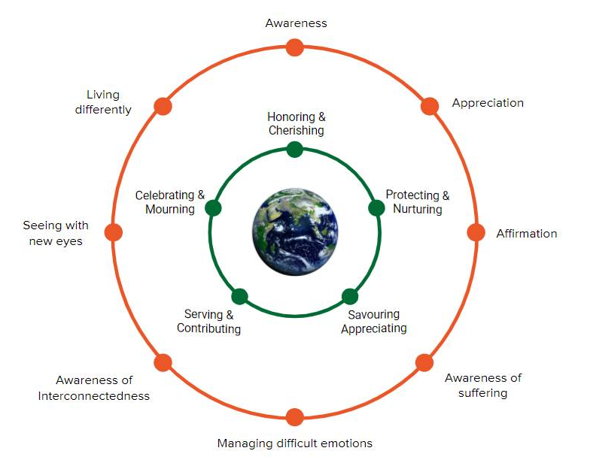
Compassion Framework
Heal Ourselves
The foundation for healing the Earth
Heal the Earth
Taking care of one another living interdependently.

Slide 5
TreasureEarth™ app
Helps users take daily concrete steps to heal the Earth by connecting with themselves.
ENERGIZE
YOUR COMMUNITY
Motivate and energize communities to move the information from the “head to heart” with our curated lessons on compassion.
DATA TRACKING & ANALYSIS
Track and capture insights of our partners’ initiatives. Measure the success of their initiatives and find out what resonates with their communities.

Slide 6
TreasureEarth™ Communities
Ability to create your own communities
National Level
School Level
Invite others to join communities
Community tasks – Share and motivate through your actions
View & Monitor community metric counter
“Like”, share and post your achievements - Have Fun - Challenge one another
Keep track of your:
Tasks
Achievements
Metrics

Slide 7
TreasureEarth™ Diary
Pre and post assessments
Reflection process
To reinforce learning
To reinforce new behaviors
Keep track of your:
Tasks
Achievements
Metrics

Slide 8
Key Information
Countries: All countries in FEE network
can join the campaign
Age group: 13 years and above
Operating Systems: Android , IOS (Apple)
Language: English (a Word document will be available for translation)
Data policy: Compliance with GDPR
Framework/App: Now.Here. – Treasure Earth
Content: Core team at FEE and Now.Here.

Slide 9
Timeline
11 March – 19 April Schools register their interest with National Operators.
7 April Interactive webinar for schools to learn more about the campaign.
8 April - 19 April National Operators send out links and activation codes to registered schools to download the TreasureEarth app.
19 April The Global Action Days campaign will become available in the TreasureEarth app. Participants can begin their journey from this date.
22 April (Earth Day) Official start of the campaign.
26 April Final date for registration.
17 May End of campaign.

Slide 10
Example of Action
Local or Exotic?
Find 7 food products in your kitchen (e.g. fruits, vegetables, rice, beans, nuts) and find out where they were produced.
Do some of these products grow naturally in your country during certain times of the year? Or are they transported to your supermarket from other countries? Consider how this might impact Climate Change.
Be inspired by this YRE video from Sweden and find out what local and seasonal food products you have in your country: https://yrecompetition.exposure.co/sweden-13
Share your findings in the App Community

Slide 11
Social Media
Hashtags:
#MyActionsMatter
#GlobalActionDays
#Handprint

Slide 12
For more information:
www.ecoschools.global/my-actions-matter
Contact you National Operator to register for the campaign.
Contact FEE Global kristina@fee.global for general questions.

Slide 13
Thank you!

